Slide 1


Cross-Same-Class Autoencoders for Improved Latent Space CA1
Arthur Lubambo
Sep 2023

Slide 2
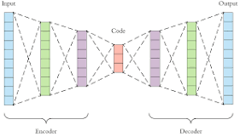
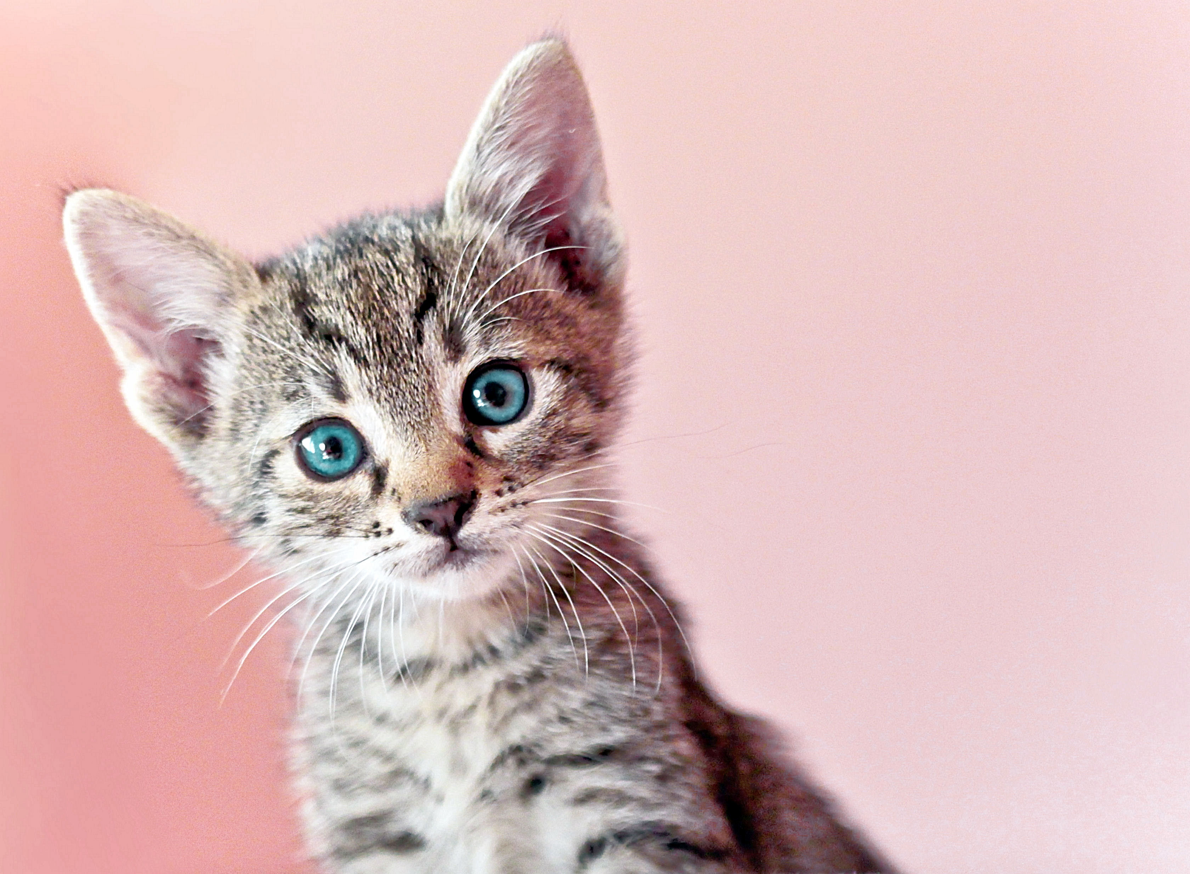
Introduction
Autoencoders
Unsupervised learning

Slide 3
Introduction
Autoencoders
Latent Space

Slide 4
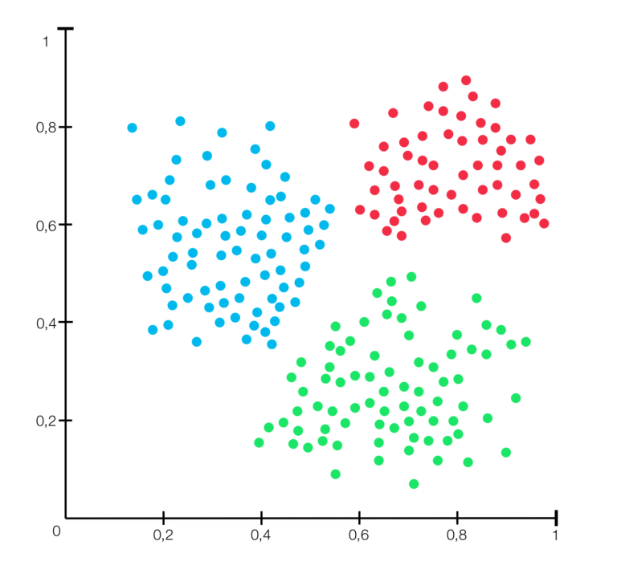
Introduction
Autoencoders
Latent Space

Slide 5
Introduction
Latent Space
Dimensionality Reduction for Classification
Clustering
Embedding

Slide 6

Introduction
Cross-Same-Class Autoencoders
Semi-Supervised Learning
Latent Space

Slide 7
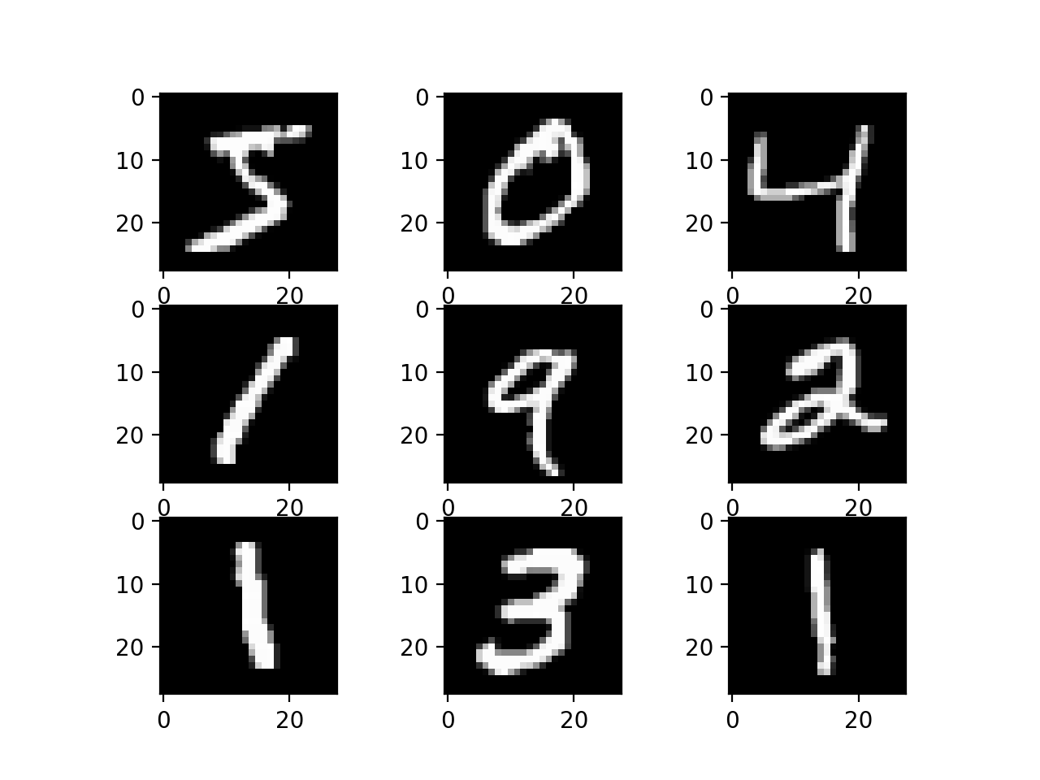
Methodology
Traditional AE vs CSC-AE
Experiments
Dataset
MNIST
Data Preparation
Architecture
Convolutional Autoencoder
Dense Autoencoder

Slide 8
Methodology
Data Preparation
Traditional
CSC
OriginalTrain
OriginalTrain
OriginalTrain
Shuffled
Test
Cross Same Class

Slide 9
Methodology
Data Preparation
Traditional
CSC
OriginalTrain
Train
Shuffled
Train
Val
Test
Val

Slide 10
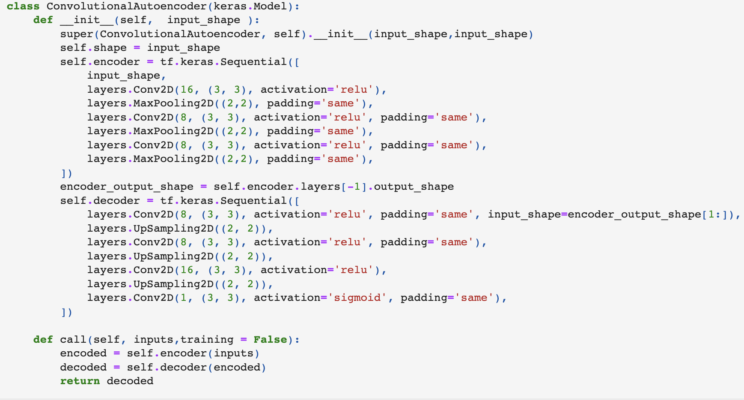
Methodology
Convolutional Autoencoder

Slide 11
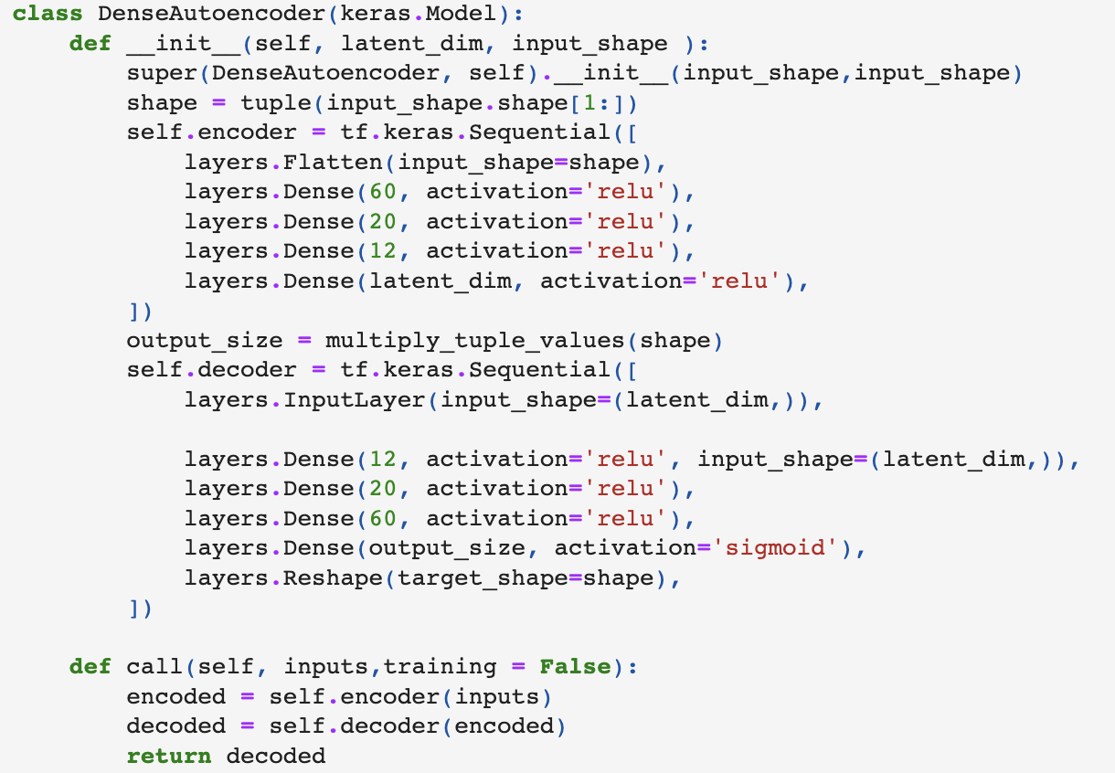
Methodology
Dense Autoencoder

Slide 12
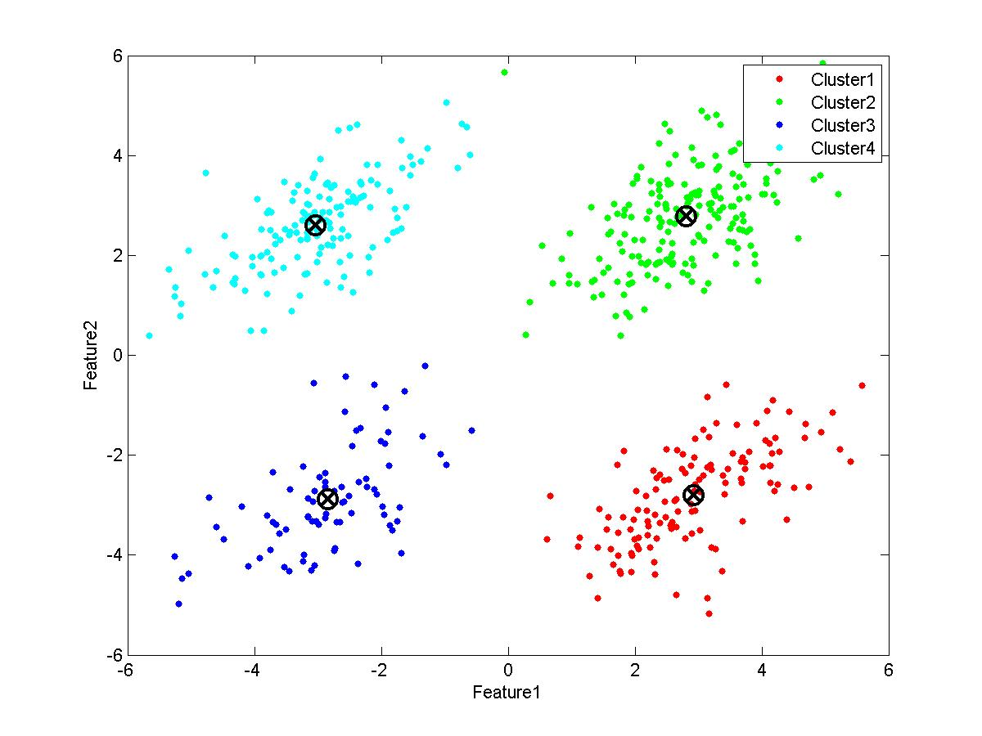
Methodology
Evaluation
Calculate Vectors in Latent Space for Test Data
Calculate Centroid for Each Class
Run KNN using centroid of each class as training
Evaluate the predicted class with the real class
F1Score
Rand Index

Slide 13
Methodology
Evaluation
Calculate Vectors in Latent Space for Test Data
Calculate Centroid for Each Class
Run KNN using centroid of each class as training
Evaluate the predicted class with the real class
F1Score
Rand Index

Slide 14
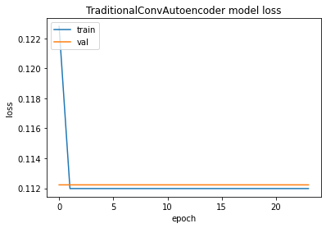
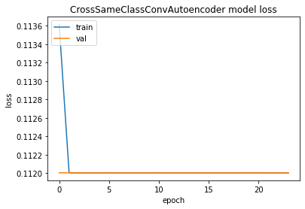
Results
Training Convolutional

Slide 15
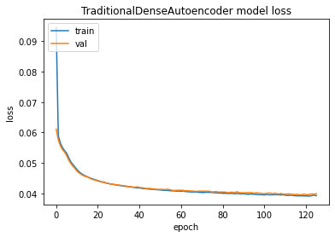
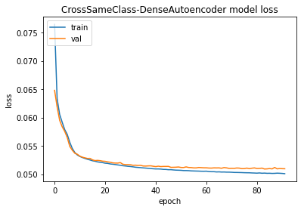
Results
Training Dense

Slide 16
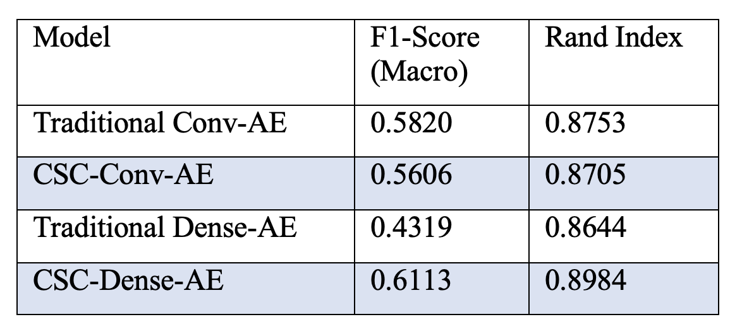
Results
Metrics

Slide 17
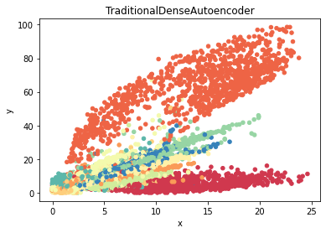
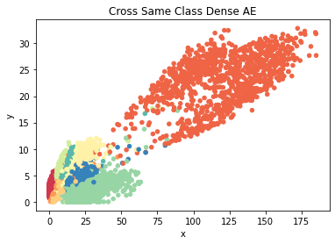
Results
2D Plots of Dense Autoencoders

